Slide 1
ARTIFICIAL NEURAL NETWORKS
Types of Problems Solved by NN

Slide 2
ARTIFICIAL NEURAL NETWORKS
Types of Problems Solved by NN

Slide 3
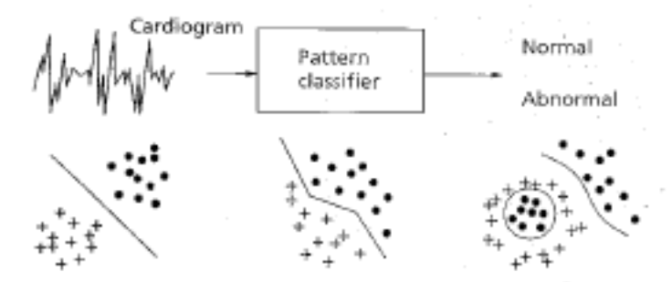
ARTIFICIAL NEURAL NETWORKS
Types of Problems which can
be solved by ANN
Pattern Classification
The task of pattern classification is to assign an input pattern (represented by a feature vector) to one of many pre -specified classes
Applications include speech recognition (speech waveforms), character recognition (handwritten symbol), EEG waveform classification, blood cell classification
Notes:
Electroencephalography (EEG) is the recording of electrical activity along the scalp.

Slide 4
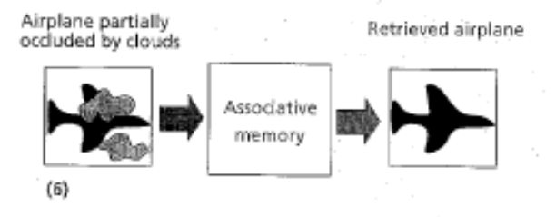
ARTIFICIAL NEURAL NETWORKS
Types of Problems which can
be solved by ANN
Pattern Completion
To complete the missing parts of a given input vector
The NN acts as an associative memory, whose contents can be recalled even by a partial input or distorted content.

Slide 5
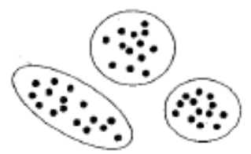
ARTIFICIAL NEURAL NETWORKS
Types of Problems which can
be solved by ANN
Clustering
In clustering, the training data is unsupervised (class labels are not available)
The similarity between patterns is explored and similar patterns are grouped together, thus forming clusters

Slide 6

ARTIFICIAL NEURAL NETWORKS
Types of Problems which can
be solved by ANN
Optimization
To find the optimal values of parameters. A wide variety of problems can be posed as optimization problems
The goal of an optimization algorithm is to find a solution satisfying a set of constraints such that an objective function is maximized or minimized (example TSP)
Some NN architectures & their training algorithms can be used to solve optimization problems

Slide 7

ARTIFICIAL NEURAL NETWORKS
Types of Problems which can
be solved by ANN
Prediction / Forecasting
Given a set of n samples in a time sequence, the task is to predict the sample n + 1
Stock market prediction and weather forecasting are typical applications of prediction techniques

Slide 8
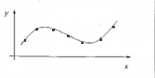
ARTIFICIAL NEURAL NETWORKS
Types of Problems which can
be solved by ANN
Function Approximation/Time Series Modeling
To learn the functional relationships between input and desired output vectors
Suppose a set of labeled training patterns (input-output pairs) have been generated from an unknown function (may be subject to noise). The task of FA is to find an estimate of the unknown function. Various engineering and scientific modeling problems require FA

Slide 9
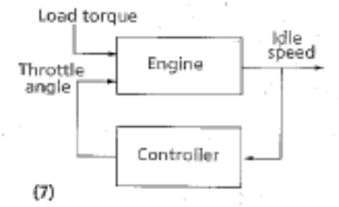
ARTIFICIAL NEURAL NETWORKS
Types of Problems which can
be solved by ANN
Control
An appropriate action is suggested, given an input vector
Consider a dynamic system defined by a tuple {u(t), y(t)}, where u(t) is the input from the controller and y(t) is the resulting output of the system at time t. The goal is to generate a control input u(t) such that the system follows a desired trajectory.

Slide 10
ARTIFICIAL NEURAL NETWORKS
Generalization and Over-fitting

Slide 11
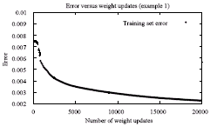
ARTIFICIAL NEURAL NETWORKS
Generalization & Overfitting
Overfitting: When to terminate the training of a network?
The obvious choice is to stop, when the error falls below a certain threshold
or
when it stops reducing significantly (reaches a plateau)

Slide 12
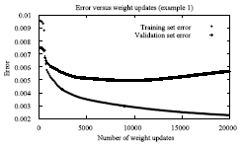
ARTIFICIAL NEURAL NETWORKS
Generalization & Overfitting
This is a poor strategy because backpropagation tends to over-fit the training examples in its effort to reduce the error
The NN memorizes the training patterns & this results in a loss of the ability to generalize

Slide 13
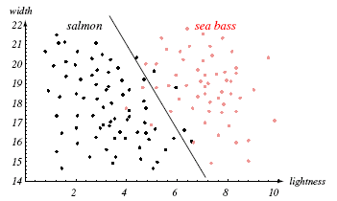
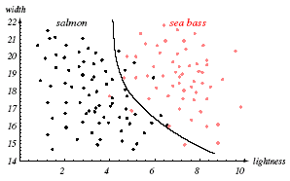
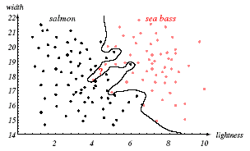
ARTIFICIAL NEURAL NETWORKS
Generalization & Overfitting

Slide 14
ARTIFICIAL NEURAL NETWORKS
Generalization & Overfitting
How to overcome the overfitting problem?
Remedies for overfitting include optimizing the network architecture and using enough training patterns
Another approach is to detect the point of overfitting by a set called validation set
For this purpose, the original data set is divided into three disjoint sets: training set, generalization set, and validation set

Slide 15
ARTIFICIAL NEURAL NETWORKS
Generalization & Overfitting
Train on the training set but monitor the performance on the validation set
Save the weights after every few iterations
The weights corresponding to the lowest error on the validation set should be used as the final weights

Slide 16
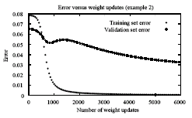
ARTIFICIAL NEURAL NETWORKS
Generalization & Overfitting
Attention: Validation error can sometimes increase and then reduce again

Slide 17
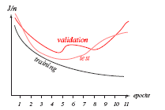
ARTIFICIAL NEURAL NETWORKS
Generalization & Overfitting
An example: Training set error, validation set error and test set error

Slide 18
ARTIFICIAL NEURAL NETWORKS
Data Preparation

Slide 19
ARTIFICIAL NEURAL NETWORKS
Data Preparation
One of the most important phases in using a NN is to collect and transform data into a form acceptable to the NN
The first step is to decide on the inputs and the outputs. Obviously irrelevant inputs should be excluded
The second step is to process the data in order to
  remove the outliers,
  handle missing data,
  transform non-numeric data to numeric, and
  to scale the data into the active range of the activation function used

Slide 20
ARTIFICIAL NEURAL NETWORKS
Data Preparation: Missing Values
For missing values in the input, the following options exists:
  Remove the entire pattern
  Replace each missing value with the average value (continuous value case) or the most frequently occurring value (discrete value case)
  For each input parameter that has a missing value, add an additional input unit to indicate patterns for which that parameter is missing. It can then be determined after training (by analyzing the weights on the links going out from that unit) whether the missing values had a significant influence on the network

Slide 21
ARTIFICIAL NEURAL NETWORKS
Data Preparation: Coding of Nominal Input Values
All input values to a NN must be numeric. Nominal values therefore need to be transformed to numerical values
A nominal input parameter that has n different values is coded as n different binary input parameters, where the input parameter that corresponds to a nominal value has the value 1, and the rest of these parameters have the value zero
Example: Apple Input x1 x2 x3
Red 1 0 0
Green 0 1 0
Yellow 0 0 1

Slide 22
ARTIFICIAL NEURAL NETWORKS
Data Preparation: Coding of Nominal Input Values
An alternative is to use just one input parameter and to map each nominal value into an equivalent numerical value. This is, however, not a good idea, since the NN will interpret the input parameter as having continuous values, thereby losing the discrete characteristic of the original data
Example: Apple Input x
Red 1
Green 2
Yellow 3

Slide 23
ARTIFICIAL NEURAL NETWORKS
Data Preparation: Input Output Scaling
It is useful to scale the input values to the active range (e.g. -1, 1) and domain (e.g. -3^{1/2}, 3^{1/2} for hyperbolic tangent) of the activation function used
Output values have to be scaled to the active range of the activation function

Slide 24
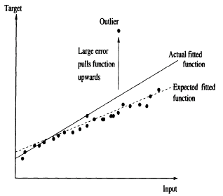
ARTIFICIAL NEURAL NETWORKS
Data Preparation: Outliers
Outliers have severe effects on accuracy, because they result in large errors, and consequently large weight updates.
The learned function is pulled towards the outliers in an attempt to reduce the training error

Slide 25
ARTIFICIAL NEURAL NETWORKS
Data Preparation: Outliers
Solution:
Remove outliers before the start of the training, using statistical techniques.
This method has the risk of eliminating important information about the data (either the outlier may be a genuine pattern, or only one parameter in the outlier may be erroneous and the other parameter values may be correct and precious)

Slide 26

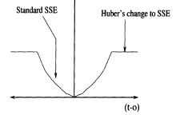
ARTIFICIAL NEURAL NETWORKS
Data Preparation: Outliers
Solution:
Use a robust error function
that is not influenced by outliers
An example is the Huber function,
shown in the figure
Patterns for which the error is larger than |α| have a constant value, and have zero influence when weights are updated (the derivative of a constant is zero)

Slide 27
ARTIFICIAL NEURAL NETWORKS
Data Preparation: Noise Injection
For problems with a limited number of training patterns, controlled injection of noise helps to generate new training patterns
It has been observed that addition of noise results in reduced training time and increased accuracy

Slide 28
ARTIFICIAL NEURAL NETWORKS
Data Preparation: Training Set Presentation Order
It is usually helpful to control the order in which the training patterns are presented for learning
If there are three classes present, it is desirable to have pattern of one class, followed by another, followed by third
If all the patterns of a class are grouped together, the network will learn very slowly or not at all
Similarly, depending upon the problem, other manipulations may be done: e.g. reduction of training patterns bunching together in the space

Slide 29
ARTIFICIAL NEURAL NETWORKS
Data Preparation: Training Set Size
Rule of thumb has been proposed
P = W/e provided training accuracy is 1 – 0.5e
Where P = number of training patterns required
W = number of weights to be trained
1 - e = classification accuracy expected
Example: If e = 0.1, W = 80 then P = 80/(0.1) = 800 patterns
are required if we want to assure 90% testing accuracy (the net has to be trained to classify 95% of training patterns correctly)

Slide 30
ARTIFICIAL NEURAL NETWORKS
References
Section 7.1.1of Engelbrecht’s book
Page 305 Fausette (Momentum)
Chapter 6 Fausette
Chapter 7 Engelbrecht

